Slide 1
Module 6: Verifying gRNA Integration in Recovered Plasmid

Slide 2
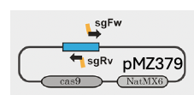
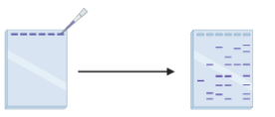
What you have done so far:
Module 1:
Module 2:
Module 3:
Module 4:
Module 5:
Designed gRNA gene sequence and primers
Inserted gRNA gene into plasmid
Checked for amplified plasmid
Transformed bacteria with plasmid
Isolated circularized plasmid from bacteria

Slide 3
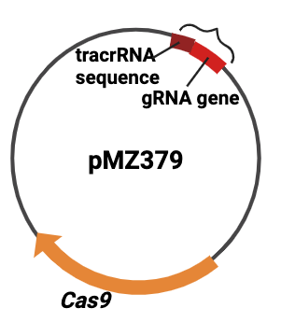
Purpose of Module 6
Verify that the gRNA gene (DNA sequence) was inserted into the plasmid via PCR.

Slide 4
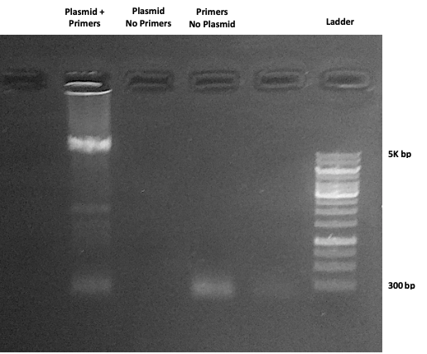
The Gel from Module 3
Can you tell if the gRNA gene is in this plasmid?
No. There is no discernable difference between a plasmid that is 10,739 bp and one that is 10,761 bp.

Slide 5
How can we verify gRNA gene insertion?
Digest (cleave) the plasmid with a restriction enzyme.

Slide 6
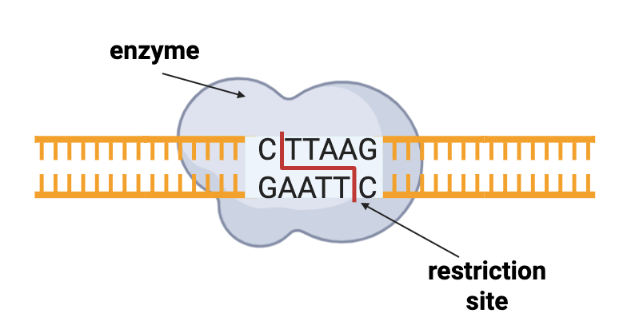
What is a restriction enzyme?
endonuclease that recognizes a specific sequence of nucleic acid
and usually cuts at or around that site
BspTI
or recognition site

Slide 7
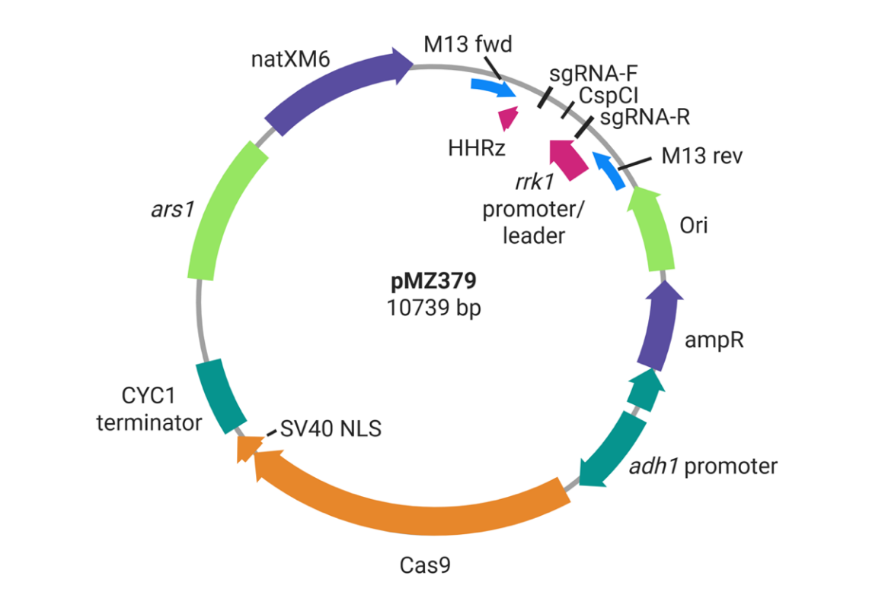
pMZ379 has a restriction site at the insertion site for the gRNA gene.
CspCI
its sequence

Slide 8
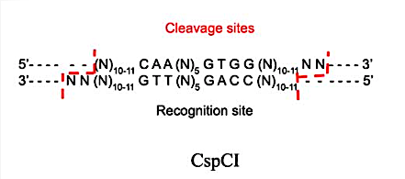
CspCI
From Citrobacter spp 2144
Recognizes 5’ CAANNNNNGTGG 3’
Cleaves outside of its recognition site
Releases fragment containing recognition site

Slide 9
pMZ379 Without gRNA Insert
CspCI site is available.
CspCI will cut the plasmid.
Plasmid will become linear.

Slide 10
pMZ379 With gRNA Insert
gRNA gene
CspCI site is NOT available.
CspCI will NOT cut the plasmid.
Plasmid will remain circular.

Slide 11
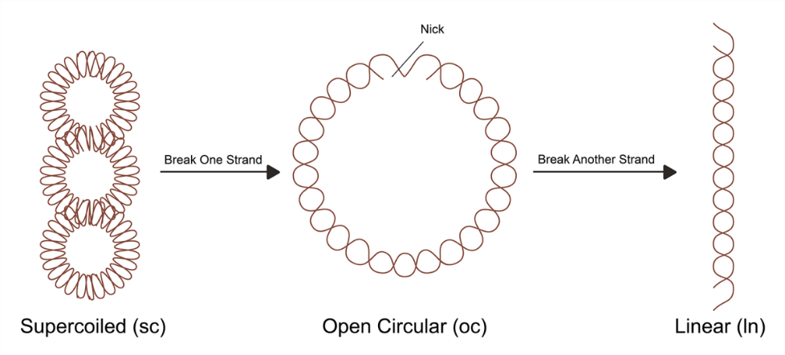
Some Forms of Plasmid
single stranded circular

Slide 12
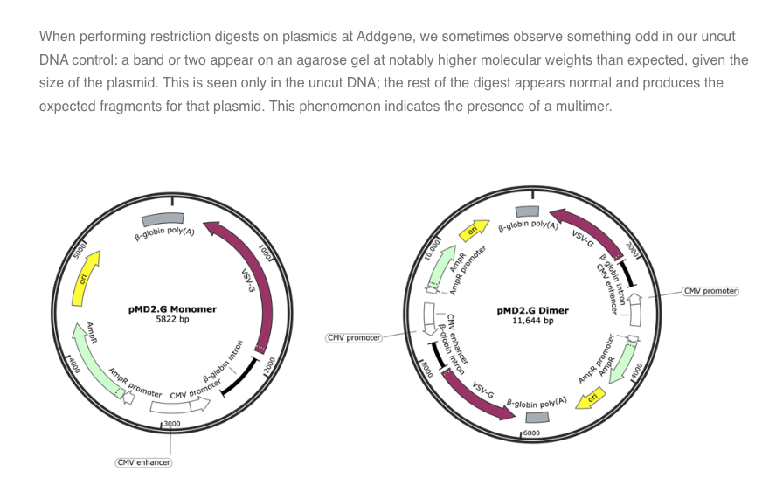
Some Forms of Plasmid
Multimer
https://blog.addgene.org/plasmids-101-dimers-and-multimers

Slide 13
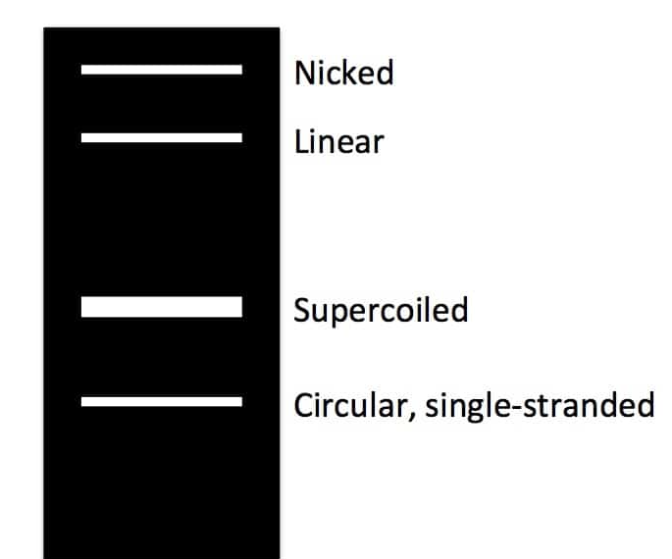
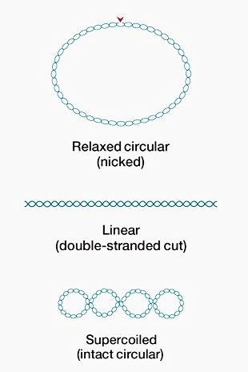
Plasmid Forms in a Gel
WELL
Multimer
*depends on temperature and gel concentration

Slide 14
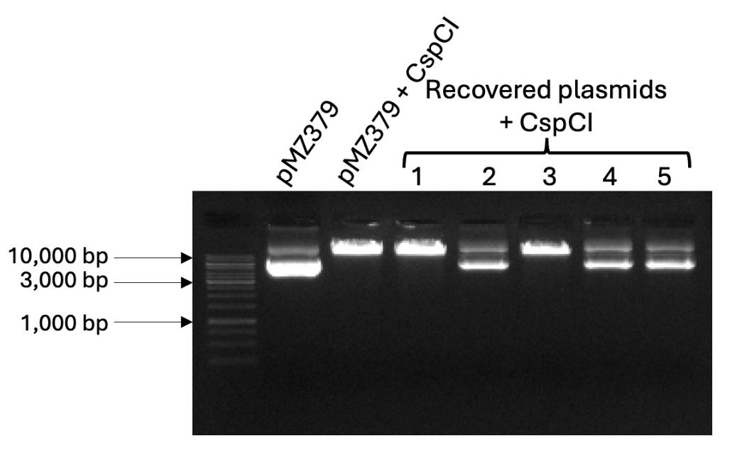
Gel Outcomes
How would you interpret the bands in each gel lane?
Lane 1
Lane 2
Lane 3
Lane 4
Lane 5
Lane 6
Lane 7
Lane 8

Slide 15
Gel Outcomes
linear (cut, no gRNA insert)
nicked?
supercoiled (uncut, gRNA insert)
Lane 1
Lane 2
Lane 3
Lane 4
Lane 5
Lane 6
Lane 7
Lane 8

Slide 16
Tips
CspCI seems to work better when allowed to digest for longer than recommended.
Use the same buffer (e.g., rCutSmart) for control AND experimental treatments.
Use 0.7% gel for best separation.

Slide 17
Using CspCI
Pros
Cons
requires only one enzyme
cheaper
requires fewer controls
enzyme is not always efficient
results are not always enlightening

Slide 18
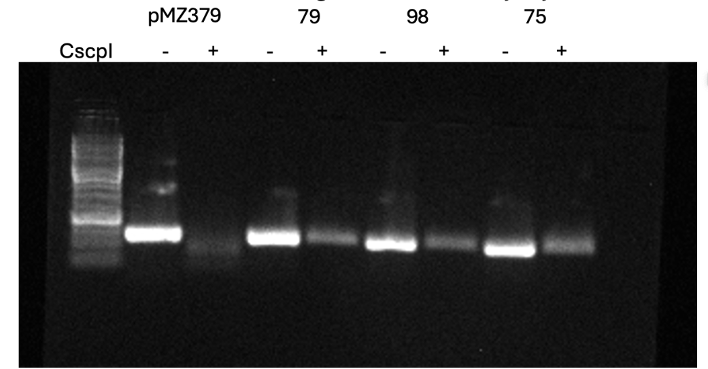
Alternative Method 1:
PCR using M13 primers
Digest smaller fragments

Slide 19
Alternative Method 2:
Send plasmid for sequencing

Slide 20
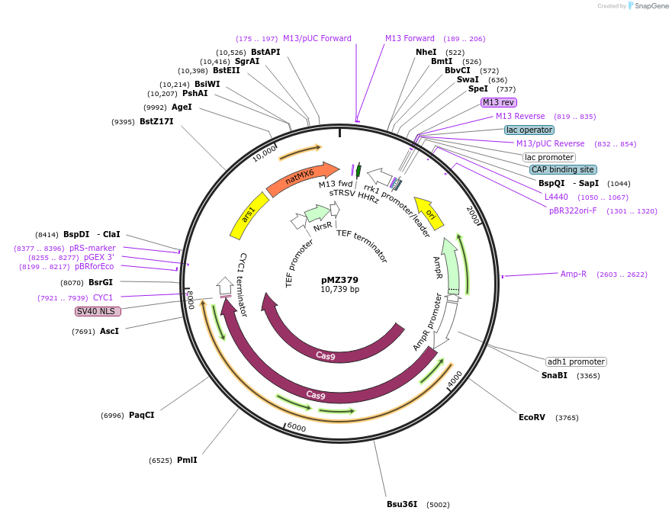
Alternative Method 3:
Use alternate restriction sites
SpeI and BsqI create 307 bp fragment
Run products on 3-4% gel

Slide 21
CspCI Digest
Start now, let run through lunch.
Run gel of products after lunch.

